Slide 1
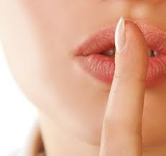
당신의 은밀한 신앙
Your Private Faith
마태복음 (Matthew) 6:1-18

Slide 2
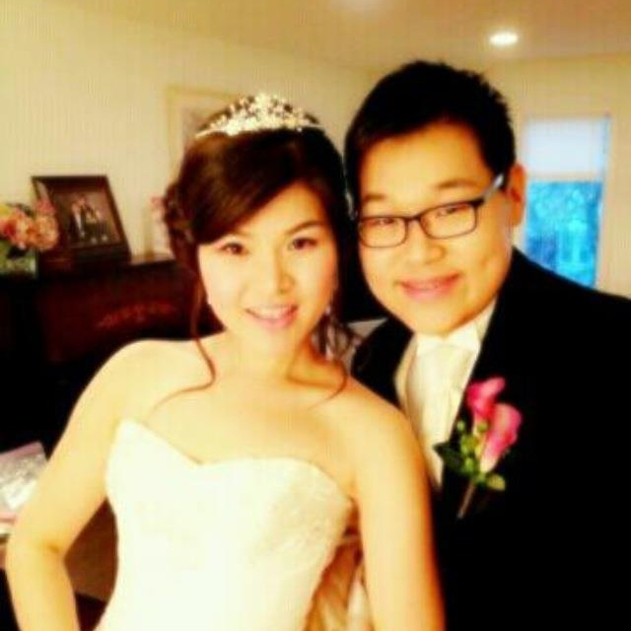
하나님은 당신을 사랑하십니다!
God loves you!
겉으로만 하는
말인가요?
Only as a show
in front of others?
True love is visible in secret moments

Slide 3
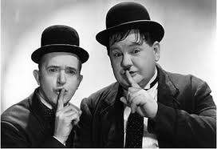
당신의 은밀한 사랑
Your Secret Love
선한 일 Good deeds (v. 1)
도움 Give (v. 2-4)
기도 Prayer (v. 5-8)
금식 Fast (v. 16-18)
그러면 은밀히 보시는 네 아버지께서 갚아 주실 것이다. (v. 18)
Father, who knows what you do in private…will reward you. (v. 18)
Notes:
What you do in front of others, there is no reward – it is actually just a religious deed
But when you do without others’ noticing, God will reward you

Slide 4

선한 일
Good Deeds
당신의 신앙 생활은 어떻습니까?
교회 나오는 것이 당신의 “의로운 일”을 채웁니까?
Does attending church fulfill your “religious duty”?
“너희는 사람들에게 보이려고 일부러 선한 일을 하지 않도록 조심하라. 그렇 지 않으면 너희가 하늘에 계신 너희 아버지에게서 상을 받지 못한다.
“Watch out! Don’t do your good deeds publicly, to be admired by others, for you will lose the reward from your Father in heaven. -Matthew 6:1
Notes:
Consider a girl buying a food from a deli and telling the boy that she made it herself, thinking that he liked homemade food – true love is real and honest – not just for show
Some people seek to maximize visibility in the church, they like the praise of others
Those that truly love God are always thinking about how they can be unto others, even preparing for the Lord’s Day worship

Slide 5
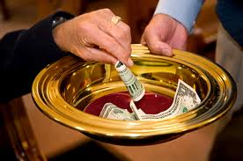
도움
Giving
헌금 기록이 없어진다면 계속 하시겠나요?
Would you continue to give offering if there were no records of your giving?
그들은 받을 상을 이미 다 받았다…은밀히 보시는 네 아버지께서 갚아 주실 것이다.
they have received all the reward they will ever get…Give your gifts in private, and your Father, who sees everything, will reward you. Matthew 6:2, 4
Notes:
Many people feel better when they give in a way that is visible – but truth, God desires you to be able to give freely because you know God gave you all things, and because of the abundance of God’s grace to you, you want to give
Talk about tithing

Slide 6
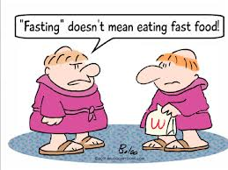
금식
Fasting
Do you fast? Has it been a time of growth for you? Why or why not?
Why do you fast?
당신이 금식을 하는 이유는?
Then no one will notice that you are fasting, except your Father, who knows what you do in private. And your Father, who sees everything, will reward you.
금식하는 것을 사람들에게 보이지 말고 보이지 않는 데 계시는 너의 아버지에게만 보여라. 그러면 은밀히 보시는 네 아버지께서 갚아 주실 것이다.
Matthew 6:18

Slide 7
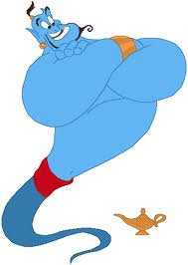
기도
Prayer
기도 시간에는 하나님과 시원한 대화를 하십니까?
During times of prayer, do you get to have an honest conversation with God?
Are you one of these kinds of people?
1. Ask all desired-requests, then calls it a prayer
2. Prays only in public setting (church), and often makes a lot of noise doing so
그러나 너는 기도할 때 골방에 들어가 문을 닫고 보이지 않는 데 계시는 네 아버지께 기도하여라. 그러면 은밀히 보시는 네 아버지께서 갚아 주실 것이다. 너희는 기도할 때 이방인들처럼 쓸데없는 말을 되풀이하지 말아라. 그들은 말을 많이 해야 하나님이 들어주실 것으로 생각한다.
But when you pray, go away by yourself, shut the door behind you, and pray to your Father in private. Then your Father, who sees everything, will reward you. “When you pray, don’t babble on and on as people of other religions do. They think their prayers are answered merely by repeating their words again and again.
Matthew 6:6-7
Notes:
Many people feel better when they give in a way that is visible – but truth, God desires you to be able to give freely because you know God gave you all things, and because of the abundance of God’s grace to you, you want to give

Slide 8

Seek His Kingdom
그의 나라를 구하라
Center your heart on God, not on yourself
Video from: King’s Speech
May your Kingdom come (나라이 임하옵시며)
May your will be done (뜻이 이루어지게 하소서)
Matthew 6:10

Slide 9


당신의 은밀한 사랑
Your Secret Love
True love occurs in private.
선한 일 Good deeds (v. 1)
도움 Give (v. 2-4)
기도 Prayer (v. 5-8)
금식 Fast (v. 16-18)
그러면 은밀히 보시는 네 아버지께서 갚아 주실 것이다. (v. 18)
Father, who knows what you do in private…will reward you. (v. 18)
Notes:
Sang’s view – so I asked throughout the week about my view on my private relationship with God. Lately, God is putting me in places where my role is to lead others – whether it be to lead my colleagues to accomplish some business objectives, to lead in the church, or even to lead my family . . . I’ve seen that many people are criticizing . . . Sang should do this, he should do that; he should have done this, he should have said this . . . It hurts whenever I hear that, and I often went to God and said this is too hard . . . I don’t want to bear this burden . . . But God tells me this is how I continue to develop my relationship with Him. He tells me to trust Him . . . I can’t please everyone, and I will never do so – He desires of me to seek Him and His kingdom only. And the Lord is pleased with me, just as I am. He is pleased with you too, just as you are. And that’s enough . . .
2. Your relationship with God matters the most
-- Preparation for Worship service – all that you do are great, but if that lessens your private relationship with God, then all is meaningless. We can do everything here without your involvement; however, as you prepare to share your faith and enable others to worship with you, that’s what forms a church.
A church is built on individuals who have a private relationship with God, secret love, private faith.
3. Throughout the week, ask yourself, how is my private relationship with God? As you work, as you study, as you meet with your friends, in your private moments, ask – how is my private relationship with God?
And share with one another during gatherings.

